Slide 1
SECURE DATA HIDING IN IMAGES USING STEGANOGRAPHY
CAPSTONE PROJECT
Presented By:
Student Name :- Danish Ahmad Paul
College Name & Department :- Govt. College for Women M.A Road Srinagar Department of Computer Application

Slide 2
OUTLINE
Problem Statement
Technology used
Wow factor
End users
Result
Conclusion
Git-hub Link
Future scope

Slide 3
Problem Statement
The project "Secure Data Hiding in Images Using Steganography" aims to develop a system that securely embeds secret messages within images using LSB (Least Significant Bit) steganography and AES encryption. This ensures data confidentiality and integrity, preventing unauthorized access. The system provides message encoding and decoding functionalities with a user-friendly interface. It enhances secure communication by hiding sensitive information in digital images.

Slide 4
Technology used
Libraries Used:
OpenCV 📷 – Image processing and manipulation
NumPy 🔢 – Numerical computations
PyCryptodome 🔐 – AES encryption for secure data protection
Streamlit 🎨 – Interactive UI for encoding and decoding
Platforms & Tools:
Programming Language: Python 3 🐍
Development Environment: VS Code
Version Control: Git & GitHub
OS Compatibility: Windows, Linux, macOS

Slide 5
Wow factors
Unique Features of This Project 🚀
Dual Security Layer 🔐 – Combines AES encryption with LSB steganography for enhanced data protection.
Pixel-Level Message Hiding 🖼️ – Uses Least Significant Bit (LSB) technique to embed data invisibly within images.
Passcode Protection 🛡️ – Requires the correct decryption key to extract the hidden message, preventing unauthorized access.
User-Friendly Interface 🎨 – Built with Streamlit, allowing seamless encoding and decoding without complex commands.
Cross-Platform Compatibility 💻 – Works on Windows, Linux, and macOS, ensuring accessibility for all users.

Slide 6
End users
Individuals : For securely sharing private information (e.g., passwords, documents).
Organizations : For confidential communication and data protection.
Government Agencies : For secure transmission of classified information.
Researchers : For experimenting with advanced steganography techniques.

Slide 7

Results
Input image

Slide 8
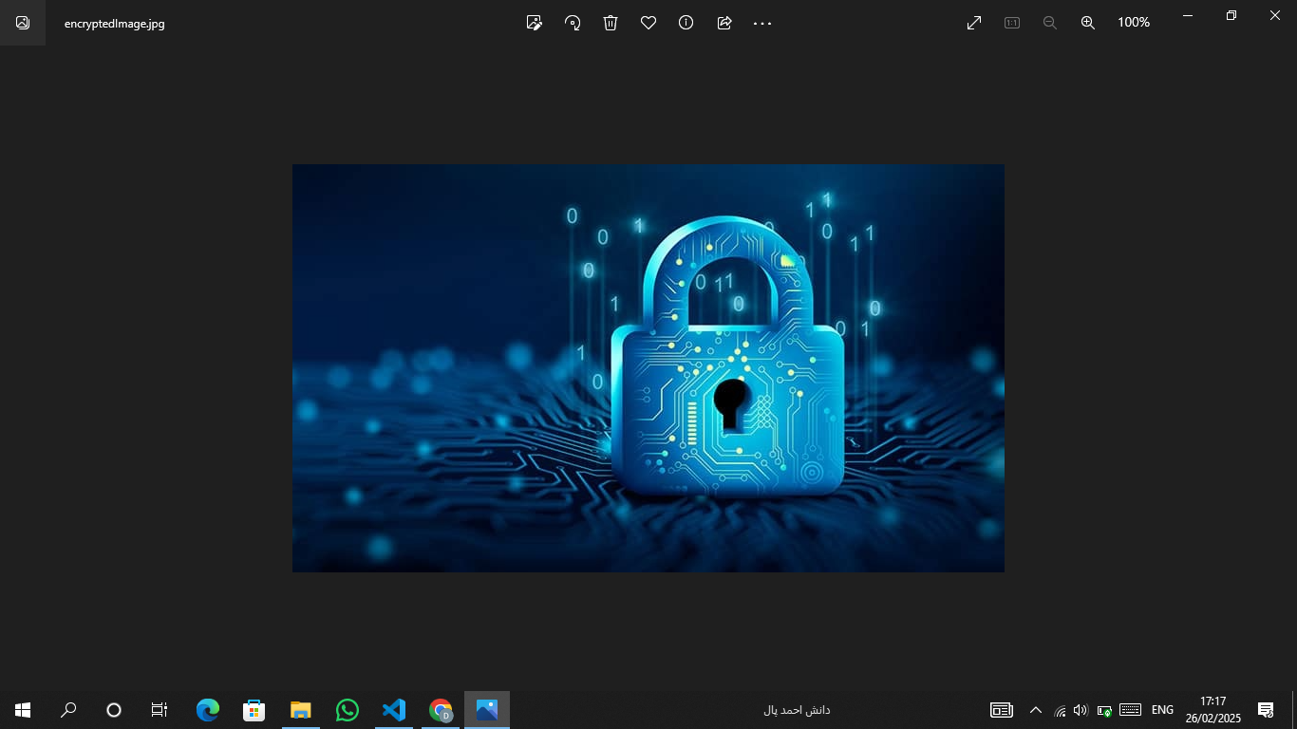
Results
Encoded Image

Slide 9

Results
Encrypted Image

Slide 10
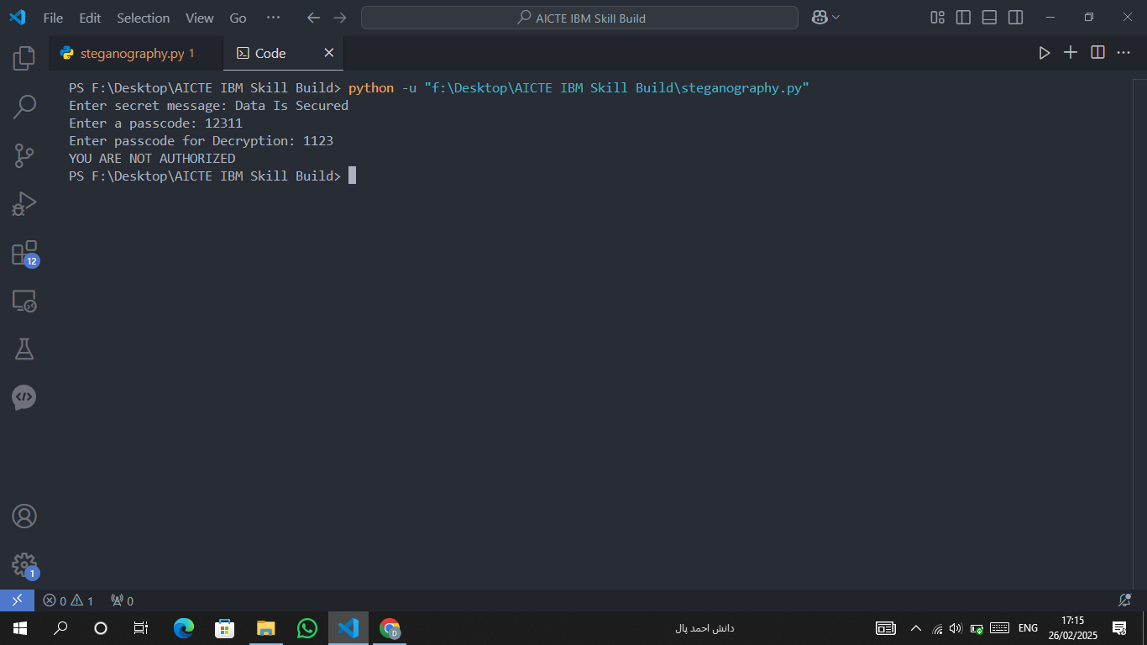
Results
Result

Slide 11
Conclusion
The project successfully implements secure data hiding in images using AES encryption and LSB steganography .
It addresses the problem of secure data transmission by combining encryption and steganography.
The solution is robust, user-friendly, and suitable for real-world applications.
Future enhancements can include support for additional file formats and improved error handling.

Slide 12
GitHub Link
https://github.com/DanishAhmadPaul/AICTE-IBM-Skill-Build-Project.git

Slide 13
Future scope(optional)
Enhanced Security with Advanced Encryption 🔐
Implementing quantum-resistant encryption algorithms to further strengthen data security.
2. Support for Multiple File Formats 📁
Expanding the tool to support JPEG, BMP, and GIF formats alongside PNG for broader usability.
3. Mobile & Web Application Development 📱💻
Developing a mobile and web-based version for easy access and secure communication on various devices.

Slide 14
THANK YOU

